Slide 1
Working Capital
It is the capital which we require to carry out day to day activities.
Gross working capital :- All current assets
Net working capital :- Current assets – Current Liabilities
Permanent Working capital :- The minimum level of current assets which is continuously required to carry the business.

Slide 2
Advantages of Adequate Working Capital
Cash Discount
Goodwill
Exploitation of good opportunities
Easy loans

Slide 3
Working Capital
Depending upon the changes in production & sales the need of WC changes
Optimum Working Capital :
Dangers in excessive WC
1 Idle funds which earn no profits for the firm
2 Heavy investment in inventories . Therefore there are chances of inventory mishandling , waste.
3 It is the indication of defective credit policy, poor collection .

Slide 4
Working Capital
Dangers in inadequate WC
1 Difficult to meet day to day expenses
2 Not able to pay current liabilities
3 The firm faces tight credit terms
4 It ceases growth.

Slide 5
Sources of working capital
1 Trade Credit
2 Bank Facilities:-
- Short term loans
- Overdraft
- Cash credit
- Bill discounting
3 Advance receipts
4 Accrued Expenses

Slide 6
Factors affecting working capital
Nature of Business , Size
Terms of purchases & sales
Manufacturing cycle, Rapidity of turnover
Dividend policy
Seasonal Variations

Slide 7
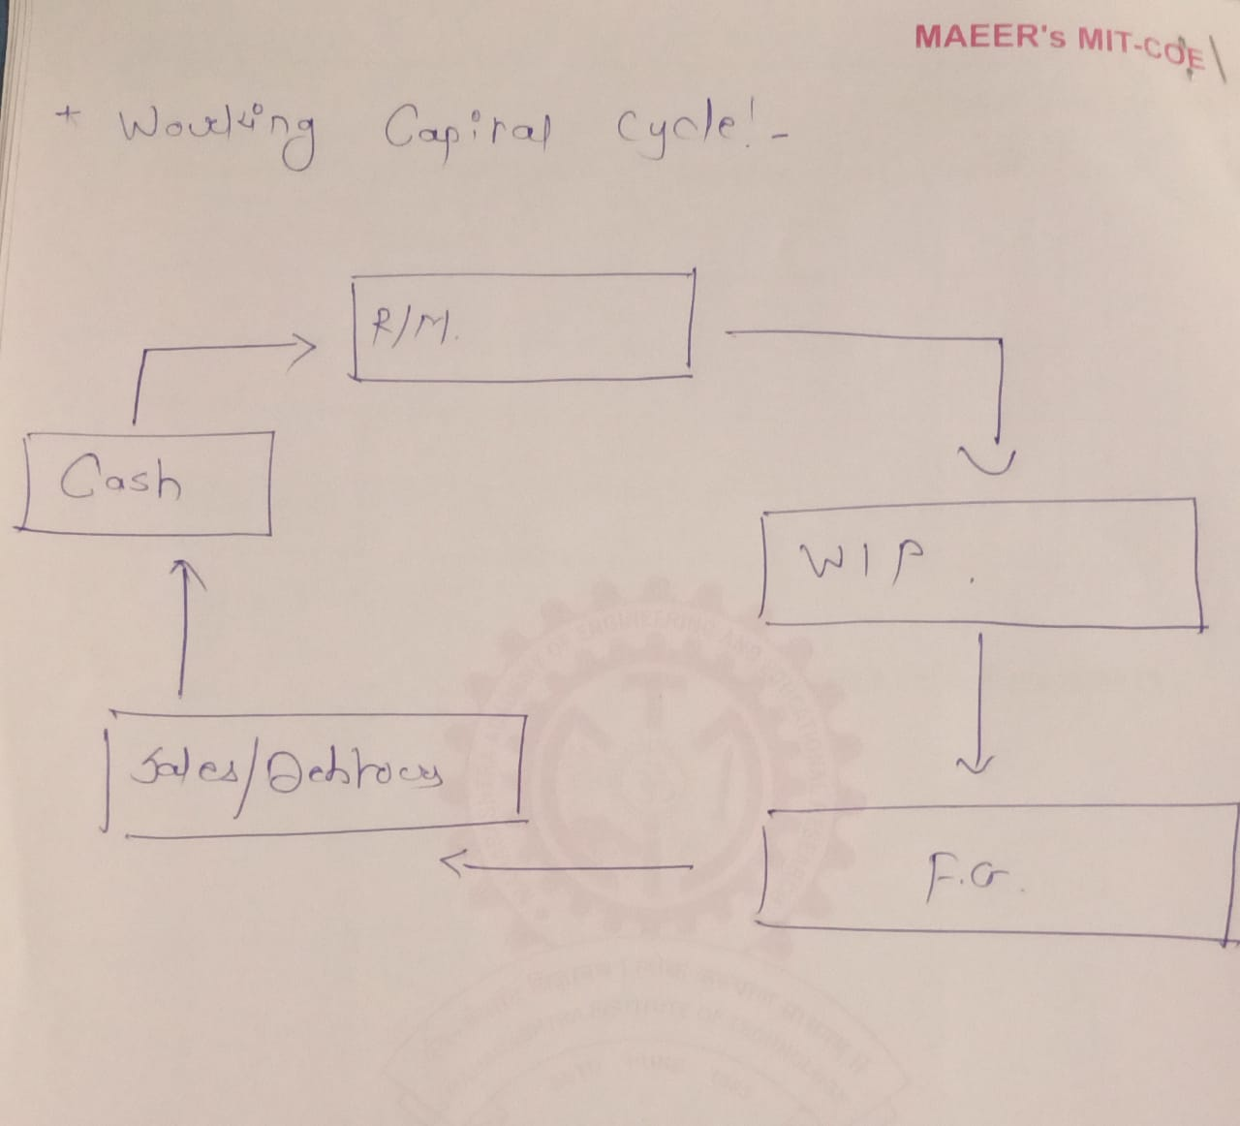

Slide 8
CA = Gross WC (-) CL = Net WC

Slide 9
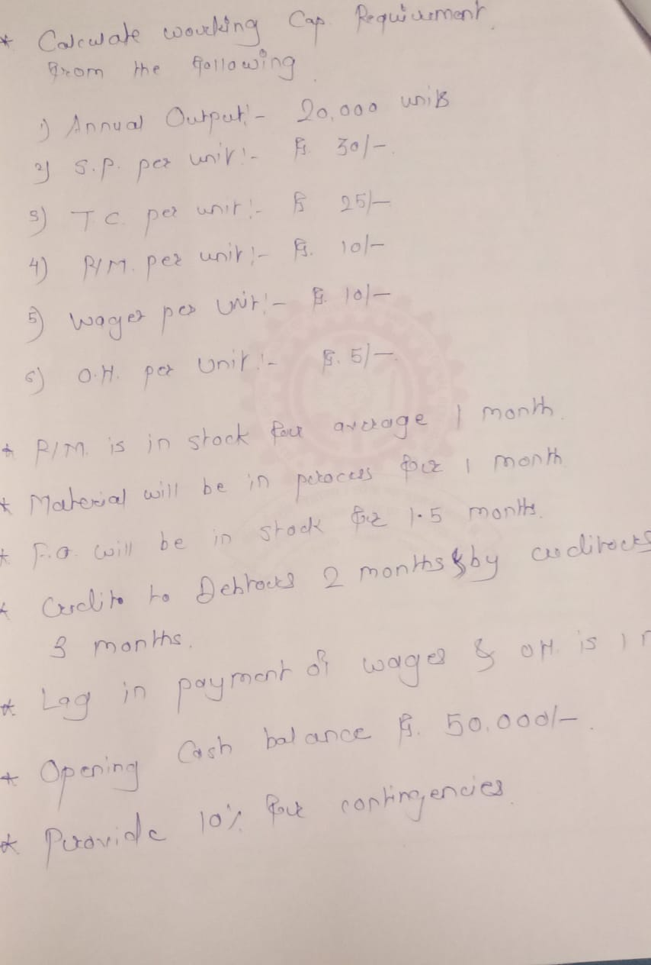

Slide 10
1)Statement of working Capital Requirement | Amount Rs. | Amount Rs.
Current Assets ;-
1) Cash |  | 50,000
2) Raw Materials (20,000*10*1/12) |  | 16,667
(output*Cost PU *Time lag)
3) WIP (20,000*17.5 *1/12) |  | 29,167
4)Finished Goods (20,000*25*1.5/12) |  | 62,500
5) Debtors (20,000*30*2/12) |  | 1,00,000
Total Current Assets |  | 2,58,334

Slide 11
WIP Calculation
Cost Component | Cost PU | Stage of completion (Assumed) | Cost PU for WIP
R/M | 10 | 100% | 10
Wages | 10 | 50% | 5
OH | 5 | 50% | 2.5
 |  | Total cost of WIP PU | Rs.17.5

Slide 12
Current Liabilities ;-
Creditors(20000*10*3/12) | 50,000
2) Wages(20000*10*1/12) | 16,667
3) Overheads (20000*5*1/12) | 8,333
Total Current Labilities |  | 75,000
(Estimated)Net Working Capital (CA- CL) | (2,58,334 -75,000) | 1,83,334
(+) 10% Contingencies (10%*1,83,334) |  | 18,334
Net WC Requirement |  | 2,01,667

Slide 14
2)From the following calculate working capital requirement
Annual Output :- 25,000 units
Cost Structure Per Unit :-
R/M Rs.15
Labour Rs.5
O.H. Rs. 7
Selling Price Rs. 30
Material will be in stock for on an average 15 days and in process for 1 month ( Assume 50% degree of completion)
Finished Goods will be stock for 1.5 month
Wages are paid with a time lag of 1 month
Credit allowed to Debtors is 1 month & by suppliers is 2 months
Opening Cash Balance is Rs. 85,000/-
Provide 15% margin for contingencies

Slide 15
Statement of working Capital Requirement
Current Assets ;-
1) Cash |  | 85,000
2) Raw Materials (25,000*15*0.5/12) |  | 15,625
3) WIP (25000*13.5*1/12) |  | 28,125
4)Finished Goods (25,000*27*1.5/12) |  | 84,375
5) Debtors (25,000*30*1/12) |  | 62,500
Total Current Assets |  | 2,75,625

Slide 16
WIP Calculation
Cost Component | Cost PU | Stage of completion | Cost PU for WIP
R/M | 15 | 50% | 7.5
Wages | 5 | 50% | 2.5
OH | 7 | 50% | 3.5
 |  | Total cost of WIP PU | Rs.13.5

Slide 17
Rm 5 3 Crs – CL
Wages 5 2 -CL
OH 5
TC = Rs.15
SP = Rs.20
Net WC = 15 – 5 = Rs.10/-

Slide 18
Current Liabilities ;-
1) Creditors (25000*15*2/12) | 62,500
2) Wages (25000*5*1/12) | 10,417
3) Overheads | -
Total Current Labilities |  | 72,917
Net Working Capital (CA-CL) |  | 2,02,708
(+) 15% Contingencies (15%*2,02,708) |  | 30,406
Net WC requirement |  | 2,33,114

Slide 19
3) From the following calculate working capital requirement
Annual Output :- 60,000 units
Annual Cost Structure :-
R/M Rs.8,00,000
Labour Rs.5,00,000
O.H. Rs. 7,00,000
Sales Rs. 30,00,000
Material will be in stock for on an average 15 days and in process for 1 month ( Assume 50% degree of completion for wages & OH , Material 100%)
Finished Goods will be stock for 1.5 month
Wages & OH are paid with a time lag of 1 month
Credit allowed to Debtors is 1 month & by suppliers is 2 months
Opening Cash Balance is Rs. 1,00,000/-
Provide 15% margin for contingencies

Slide 20
Statement of working Capital Requirement
Current Assets ;-
1) Cash |  | 1,00,000
2) Raw Materials (8,00,000*0.5/12) |  | 33,333
3) WIP (14,00,000*1/12) |  | 1,16,667
4)Finished Goods (20,00,000*1.5/12) |  | 2,50,000
(Total Cost of FG= 8,00000+5,00,000+7,00,000 = Rs.20,00,000)
5) Debtors (30,00,000*1/12) |  | 2,50,000
Total Current Assets |  | 7,50,000

Slide 21
WIP Calculation
Cost Component | Annual Cost | Stage of completion | Cost for WIP
R/M | 8,00,000 | 100% | 8,00,000
Wages | 5,00,000 | 50% | 2,50,000
OH | 7,00,000 | 50% | 3,50,000
 |  | Total cost of WIP | 14,00,000

Slide 22
Current Liabilities ;-
1) Creditors (8,00,000*2/12) | 1,33,334
2) Wages (5,00,000*1/12) | 41,667
3) Overheads (7,00,000*1/12) | 58,334
Total Current Labilities |  | 2,33,335
Net Working Capital (CA-CL) |  | 5,16,668
(+) 15% Contingencies (15%*5,16,668) |  | 77,500
Net WC requirement |  | 5,94,168

Slide 23
4)From the following calculate working capital requirement
Annual Output :- 60,000 units
Per Unit Cost Structure :-
R/M Rs.8,
Labour Rs.4
O.H. Rs. 7
Sales Rs. 25
Material will be in stock for on an average 15 days and in process for 1 month ( Assume 50% degree of completion for wages & OH , Material 100%)
Finished Goods will be stock for 1.5 month
OH are paid with a time lag of 1 month
Wages are paid on 10th day of each month.
20% of the sales will be on cash
Credit allowed to Debtors is 1 month & by suppliers is 2 months
Opening Cash Balance is Rs. 1,00,000/-
Provide 15% margin for contingencies

Slide 24
Statement of working Capital Requirement
Current Assets ;-
1) Cash | 1,00,000
Cash from Cash sales (20% *(60000*25)) | 3,00,000 | 4,00,000
2) Raw Materials
(60000*8*0.5/12) |  | 20,000
3) WIP
(60000*13.5*1/12) |  | 67,500
4)Finished Goods
(60000*19*1.5/12) |  | 1,42,500
5) Debtors (48000*25*1/12)
Credit Sales = 80%*60,000units= 48000units |  | 1,00,000
Total Current Assets |  | 7,30,000

Slide 25
WIP Calculation
Cost Component | Cost PU | Stage of completion | Cost PU for WIP
R/M | 8 | 100% | 8
Wages | 4 | 50% | 2
OH | 7 | 50% | 3.5
 |  | Total cost of WIP PU | 13.5

Slide 26
Current Liabilities ;-
1) Creditors
(60000*8*2/12) | 80,000
2) Wages
(60000*4*1/12) | 20,000
3) Overheads
(60000*7*1/12) | 35,000
Total Current Labilities |  | 1,35,000
Net Working Capital |  | 5,95,000
(+) 15%contingencies(15% * 5,95,000) |  | 89,250
Net WC requirement |  | 6,84,250

Slide 27
5) From the following calculate working capital requirement
Annual Output :- 50,000 units
Annual Cost Structure :-
R/M Rs.10,00,000
Labour Rs.5,00,000
O.H. Rs. 5,00,000
Sales Rs. 30,00,000
Material will be in stock for on an average 30 days and in process for 1.5 month ( Assume 50% degree of completion for wages & OH , Material 100%)
Finished Goods will be stock for 1 month
OH are paid with a time lag of 1 month
Credit allowed to Debtors is 1 month & by suppliers is 2 months
Annual Insurance Premium of the company is Rs. 1,50,000/- which is paid quarterly in advance.
Opening Cash Balance is Rs. 1,00,000/-
Provide 10% margin for contingencies

Slide 28
Statement of working Capital Requirement
Current Assets ;-
1) Cash |  | 1,00,000
2) Raw Materials
(10,00,000*1/12) |  | 83,334
3) WIP
(15,00,000*1.5/12) |  | 1,87,500
4)Finished Goods
(20,00,000*1/12) |  | 1,66,667
5) Debtors
(30,00,000*1/12) |  | 2,50,000
6) Insurance Prem.(Prepaid :- 1,50,000/4) |  | 37,500
Total Current Assets |  | 8,25,000

Slide 29
WIP Calculation
Cost Component | Annual Cost | Stage of completion | Cost for WIP
R/M | 10,00,000 | 100% | 5,00,000
Wages | 5,00,000 | 50% | 2,50,000
OH | 5,00,000 | 50% | 2,50,000
 |  | Total cost of WIP | 15,00000

Slide 30
Current Liabilities ;-
1) Creditors
(10,00,000*2/12) | 1,66,667
2) Wages | -
3) Overheads | 41,667
(5,00,000*1/12)
Total Current Labilities |  | 2,08,334
Net Working Capital (CA-CL) |  | 6,16,667
(+) 10%contingencies |  | 61,667
Net WC requirement |  | 6,78,334

Slide 31
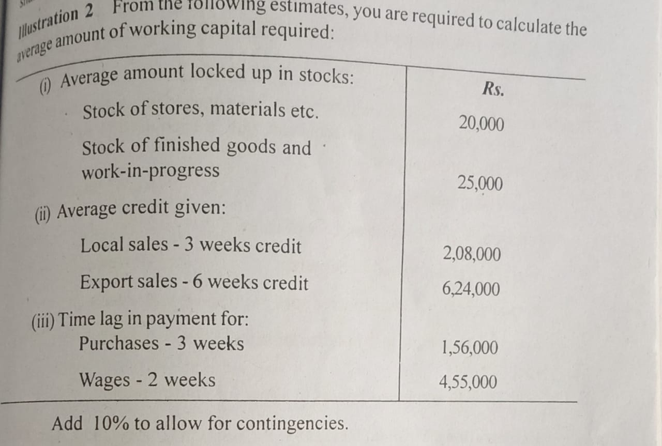

Slide 32
6) Statement of working Capital Requirement
Current Assets ;-
1) Raw Materials |  | 20,000
2) WIP & Finished Goods |  | 25,000
3) Debtors
Local sales (208000*3/52) |  | 12000
Export Sales (624000*6/52) |  | 72000
Total Current Assets |  | 1,29,000

Slide 33
Current Liabilities ;-
1) Creditors (156000*3/52) | 9,000
2) Wages (4,55,000*2/52) | 17,500
Total Current Labilities |  | 26,500
Net Working Capital |  | 1,02,500
(+) 10% contingencies |  | 10,250
Net WC requirement |  | 1,12,750

Slide 34
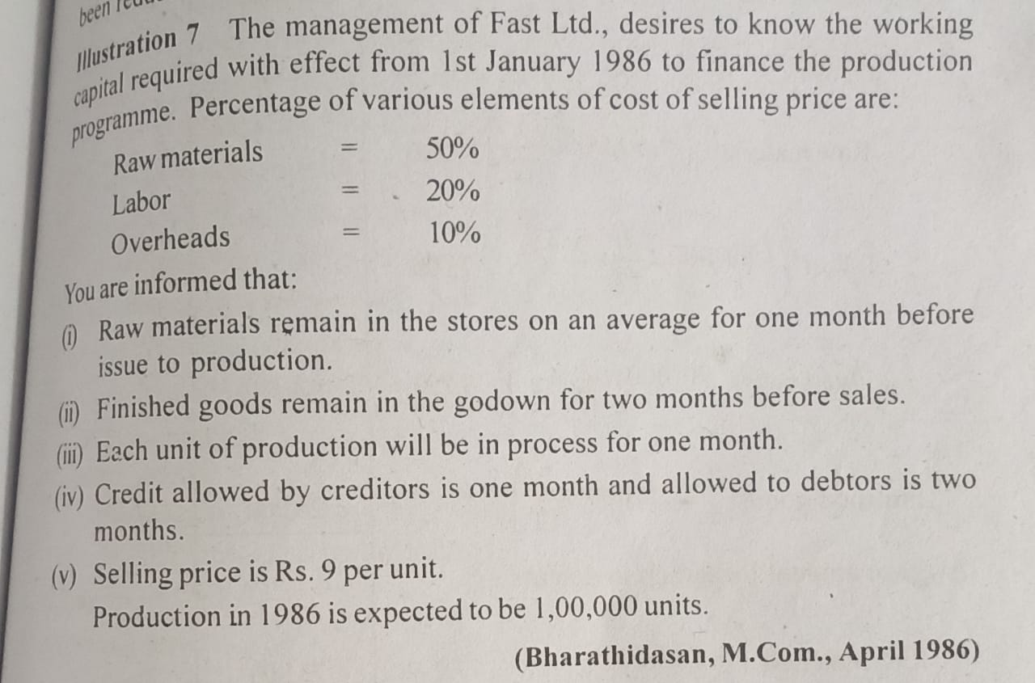

Slide 35
7) Statement of working Capital Requirement
Current Assets ;-
1) Cash |  | -
2) Raw Materials
(1,00,000*4.5*1/12) |  | 37,500
3) WIP
(1,00,000*5.85*1/12) |  | 48,750
4)Finished Goods
(1,00,000*7.2*2/12) |  | 1,20,000
5) Debtors
(1,00,000*7.2*2/12) |  | 1,20,000
Total Current Assets |  | 3,26,250
Cost Structure | PU Rs
R/M (50%* RS.9) | 4.5
Labour (20% * Rs.9) | 1.8
OH (10% * Rs.9) | 0.9
Total Cost | 7.2

Slide 36
WIP Calculation
Cost Component | Cost PU | Stage of completion | Cost PU for WIP
R/M | 4.5 | 100% | 4.5
Wages | 1.8 | 50% | 0.9
OH | 0.9 | 50% | 0.45
 |  | Total cost of WIP PU | 5.85

Slide 37
Current Liabilities ;-
1) Creditors
(1,00,000*4.5*1/12) |  | 37,500
2) Wages | -
3) Overheads | -
Total Current Labilities |  | 37,500
Net Working Capital |  | 2,88,750

Slide 38
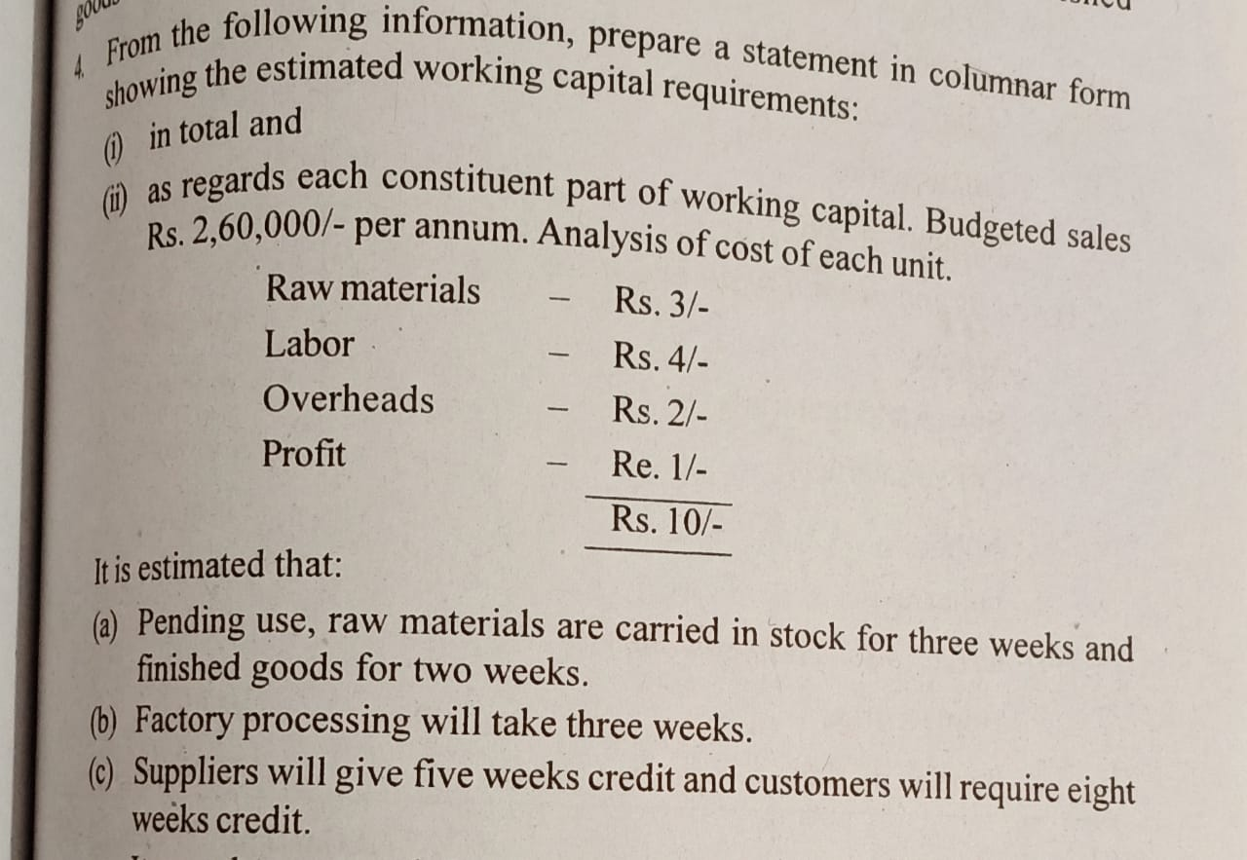

Slide 39
8) Statement of working Capital Requirement
Current Assets ;-
1) Cash |  | -
2) Raw Materials
(26000*3*3/52) |  | 4500
3) WIP
(26000*6*3/52) |  | 9000
4)Finished Goods
(26000*9*2/52) |  | 9000
5) Debtors
(26000*10*8/52) |  | 40000
Total Current Assets |  | 62,500

Slide 40
WIP Calculation
Cost Component | Cost PU | Stage of completion(Assumed) | Cost PU for WIP
R/M | 3 | 100% | 3
Wages | 4 | 50% | 2
OH | 2 | 50% | 1
 |  | Total cost of WIP PU | 6

Slide 41
Current Liabilities ;-
1) Creditors
(26000*3*5/52) | 7500
2) Wages | -
3) Overheads | -
Total Current Labilities |  | 7500
Net Working Capital |  | 55,000

